Slide 1


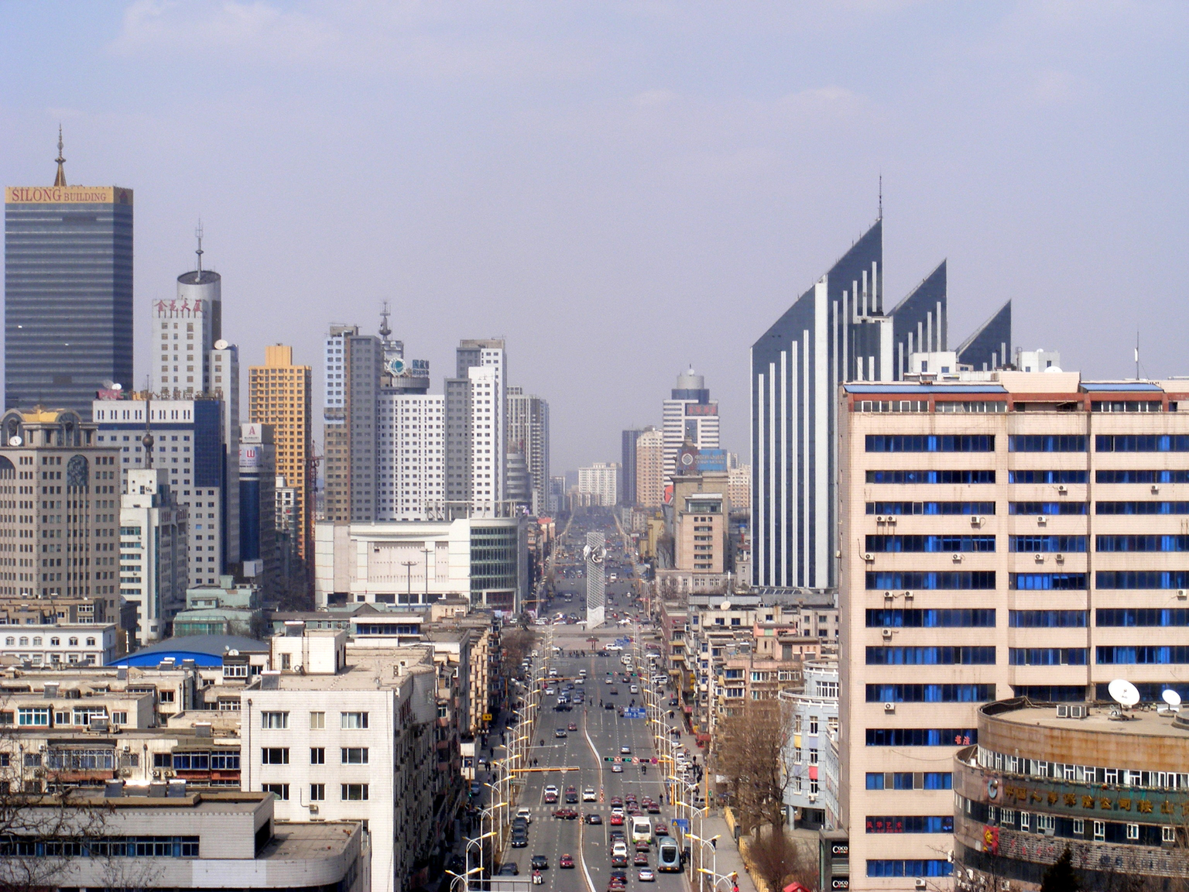

Learn
Mandarin
and you can go anywhere under the sky.

Slide 2
“WHERE DID YOU COME FROM”
2

Slide 3
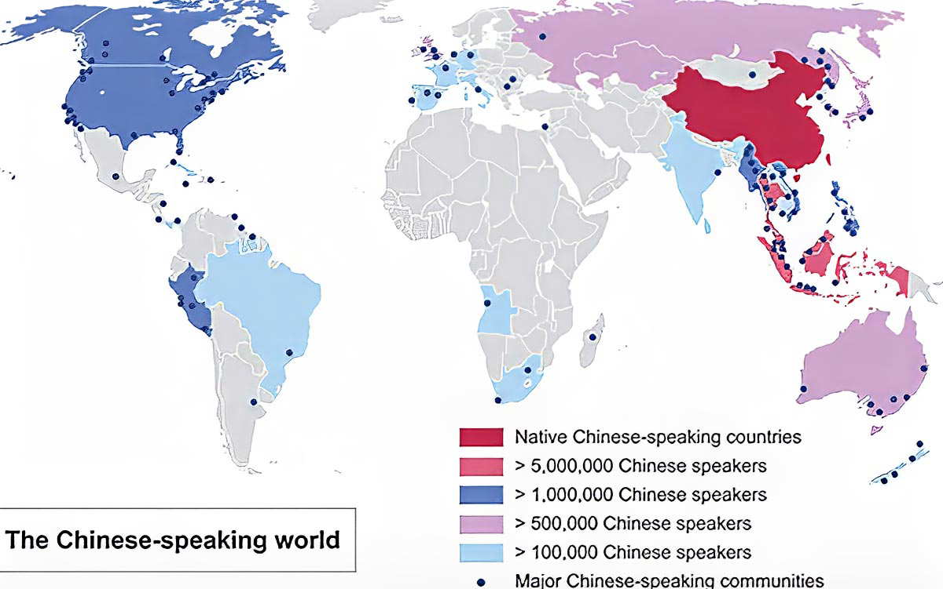
Where it is spoken?
3

Slide 4
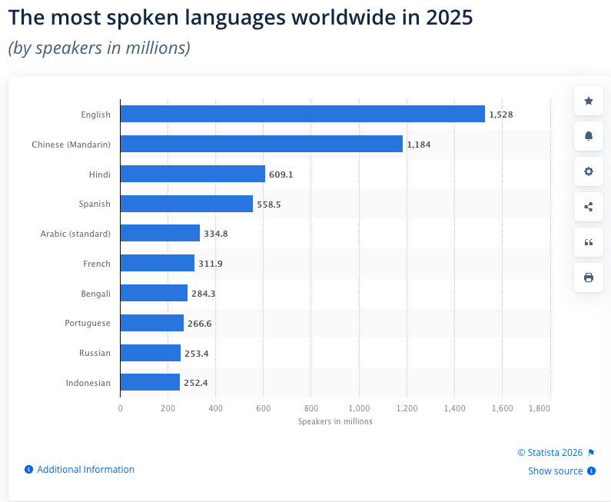
How many speakers
https://www.statista.com/statistics/266808/the-most-spoken-languages-worldwide/

Slide 5
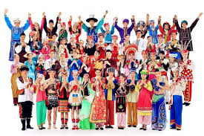
dialect 方言
Major Groups: Linguists generally divide Chinese into 7–10 main groups: Mandarin, Wu, Yue (Cantonese), Min, Gan, Xiang, Hakka, Huizhou, Pinghua, and Jin.
Mandarin Dominance: Mandarin (including Beijing dialect, Sichuanese, etc.) is the most spoken, but it differs significantly from others
Mutual Intelligibility: Many "dialects" are distinct languages; for example, a Cantonese speaker cannot understand Mandarin without learning it.
Total Languages: According to Ethnologue, there are over 281 to 302 individual living languages spoken in China.
4

Slide 6
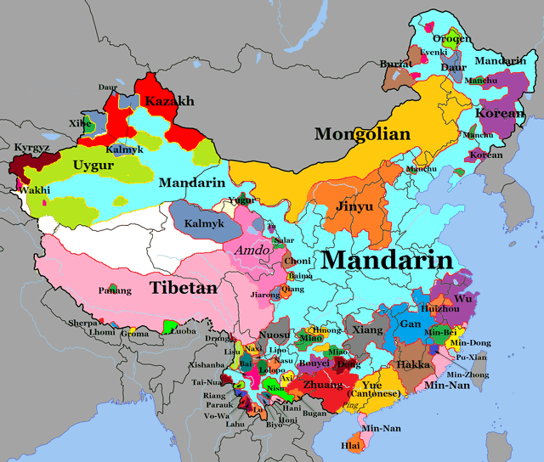
dialect 方言
4

Slide 7
Kahoot
电脑 = electronic brain
火车 = fire vehicle
手机 = hand machine
飞机 = flying machine
=== Fun / mind-blowing ones (crowd favourites) ===
熊猫 = bear cat
袋鼠 = pocket mouse
热狗 = hot dog
马马虎虎 = horse horse tiger tiger (so-so)
人山人海 = people mountain people sea (huge crowd)
吃瓜 = eat melon (watch drama)
打酱油 = buy soy sauce (none of my business / just passing by
=== Food & life ===
早餐 = morning meal
晚餐 = evening meal
开水 = open water (boiled water)
水果 = water fruit
干杯 = dry cup (cheers!)
加油 = add oil (keep going!)

Slide 8
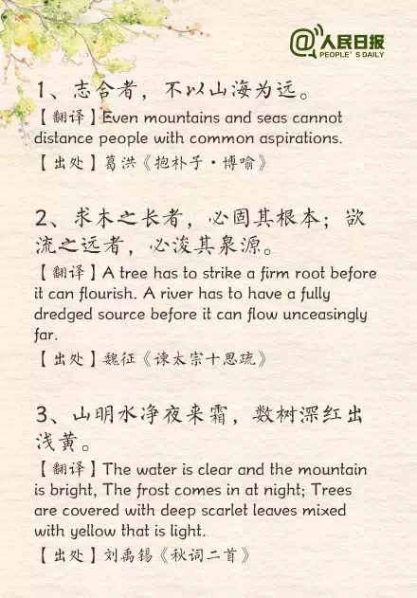
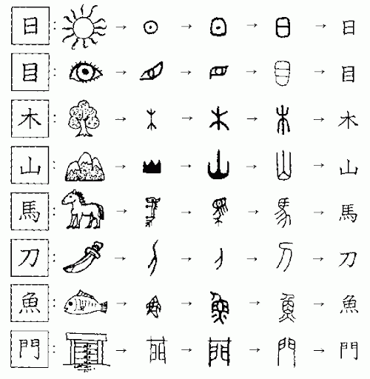
Character
5

Slide 9
Thank you

